Slide 1
Continuous Delivery

Slide 2
Agenda
Why CD ?
What is CD ?
Tooling landscape
CD with jenkins
Hands on using jenkins

Slide 3
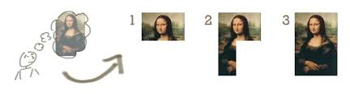
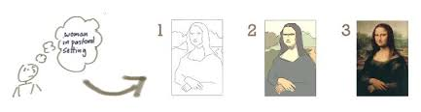
Why CD

Slide 4
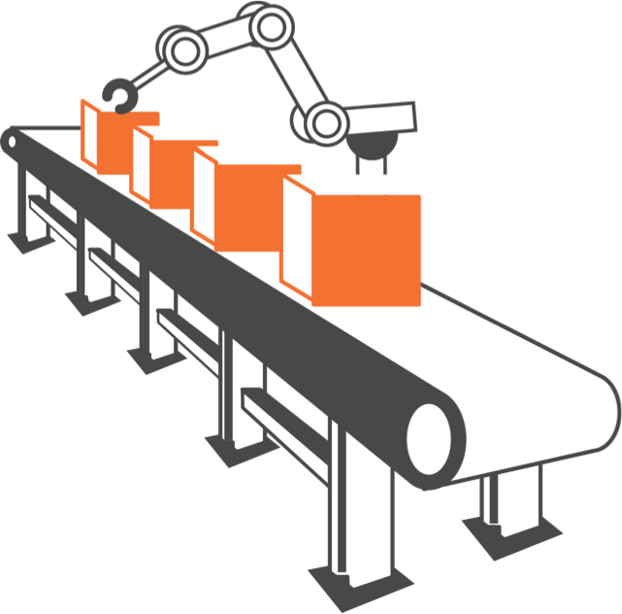
Why CD
Reduced risk
Repeatable and reliable process
Flexible release options
Automated testing
Optimising our deployment time
Capacity and Scale.
Automated deployment
Automated Rollback
Short Lived Code Branches

Slide 5
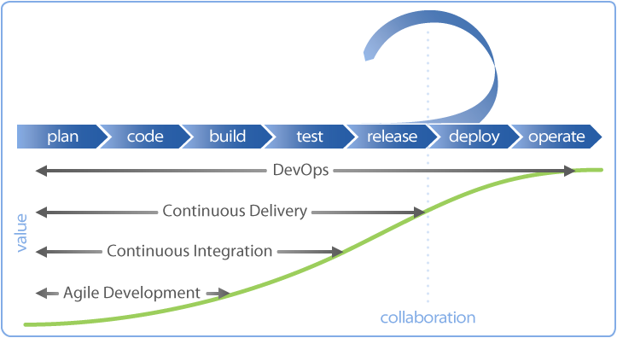

Slide 6
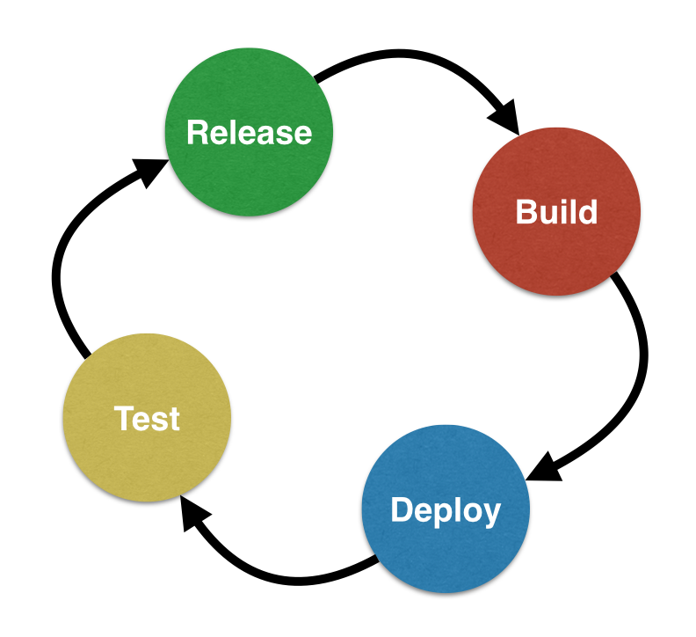
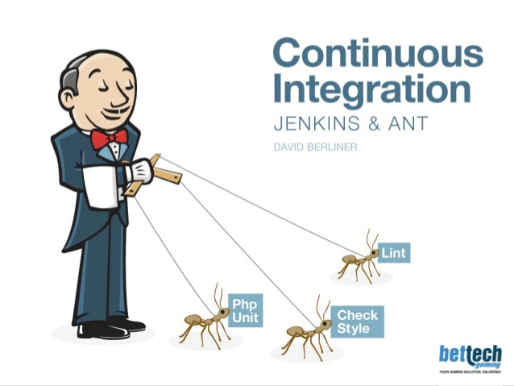
What is Continuous Delivery
Continuous delivery (CD) is a software engineering approach in which teams produce software in short cycles, ensuring that the software can be reliably released at any time. It aims at building, testing, and releasing software faster and more frequently.(source:https://en.wikipedia.org)

Slide 7
“Continuous Delivery is about putting the release schedule in the hands of the business, not in the hands of IT. Implementing Continuous Delivery means making sure your software is always production ready throughout its entire lifecycle – that any build could potentially be released to users at the touch of a button using a fully automated process in a matter of seconds or minutes.
This in turn relies on comprehensive automation of the build, test and deployment process, and excellent collaboration between everyone involved in delivery – developers, testers, DBAs, systems administrators, users, and the business. In the world of Continuous Delivery, developers aren’t done with a feature when they hand some code over to testers, or when the feature is “QA passed”. They are done when it is working in production. That means no more testing or deployment phases, even within a sprint (if you’re using Scrum).”
[Source Jez Humble, August 13th, 2010]

Slide 8







Tooling Landscape

Slide 9
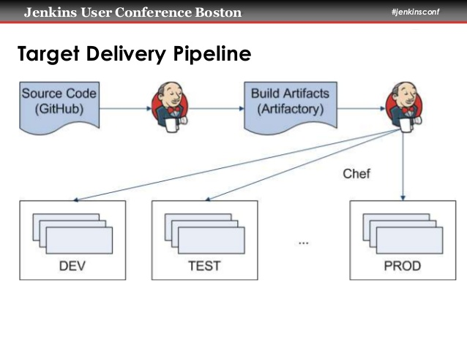
CD with Jenkins
Phases:
Artifact gathering
Collect specific artifact from artifact repository.
Smoke testing
Ensuring that the most important functions work.
Code deploy to pre-production
Deploy your code to similar to production env.
Acceptance
Acceptance for stable build
Manual Code deploy to production
Ship code to live server

Slide 10
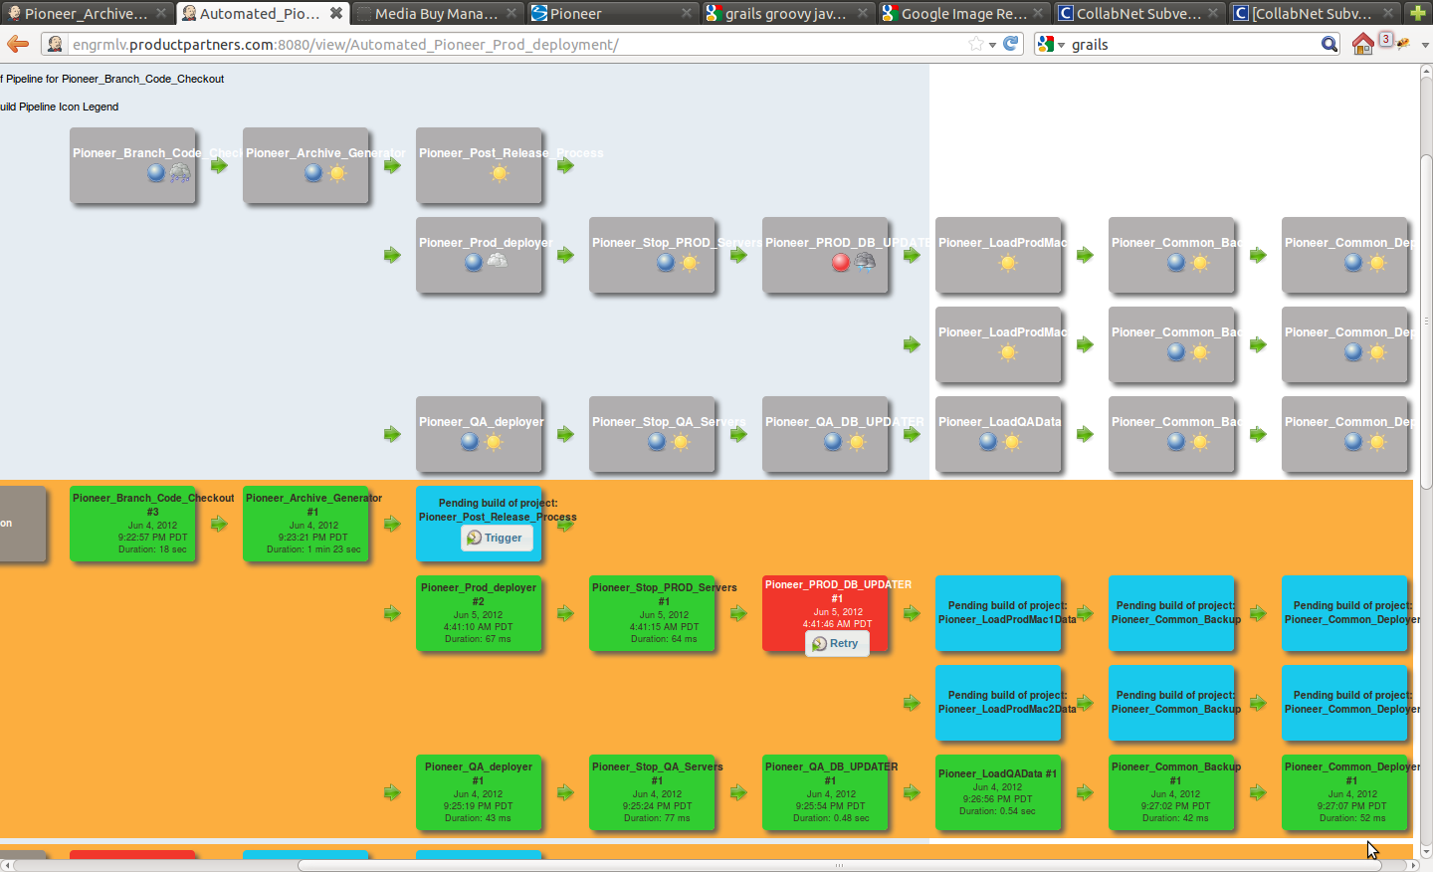

Slide 11

Hands On using Jenkins
Create deployment job:
To take artifact from artifact repository.
Deploy latest artifact into production server.
Testing:
Do automated UI testing
Ensure important functions working fine manually.

Slide 12

Questions ?

